Slide 1
Performance Program Application
Plato Static Analysis
Peter Essman

Slide 2
Output from Plato
The Plato module creates a report directory in where the command is issued. It includes multiple files but the main file used is an HTML file that is used to display the information to the user. It includes the following information:
The average lines of code across .js files
A maintainability score that gives a sense of how difficult it will be to keep the file up to date
The number of errors found

Slide 3
Issues Found
Mostly missing semicolon problems found across our teams application
This issues doesn’t cause problems but semicolons make code more readable
Other issues found revolve around type casts of boolean comparison operators.
I didn’t fix these issues but will report them to members that work with these sections of our project for fixes in the future
Anonymous functions also appear to trigger a potential warning but will need to look into this to see why

Slide 4
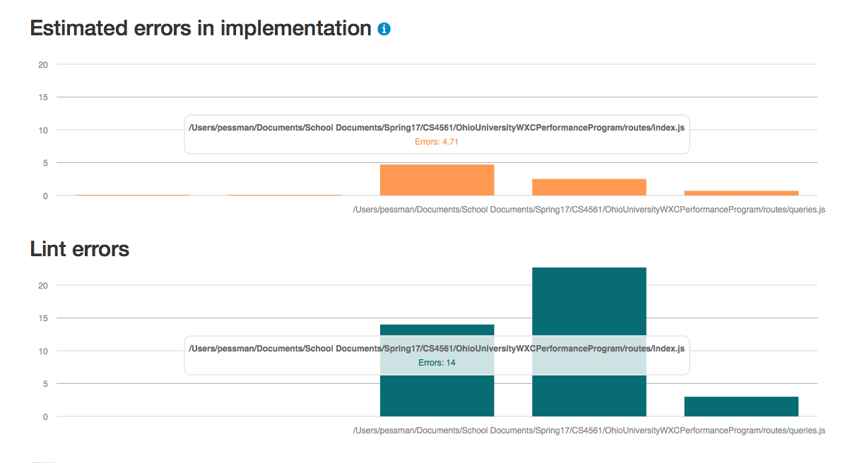
Initial Output

Slide 5
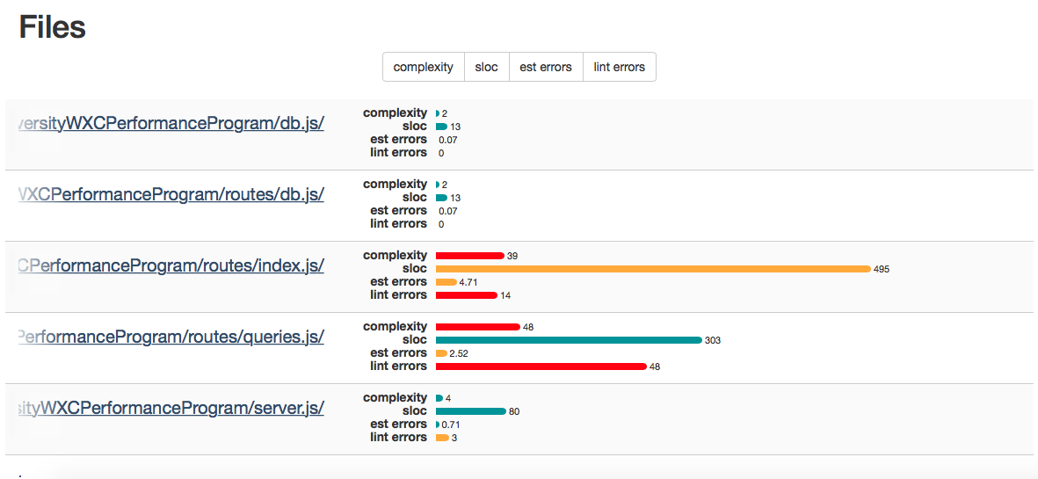
Initial Output Cont’d

Slide 6
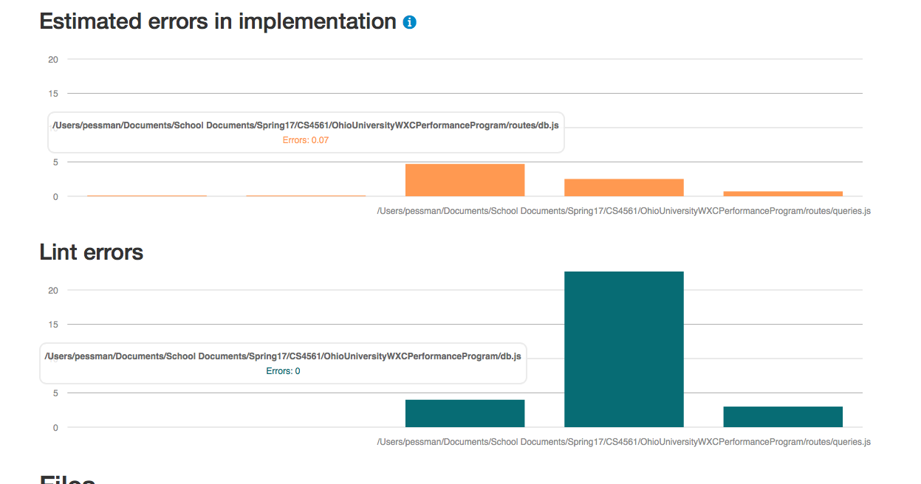
Output Post-Fix

Slide 7
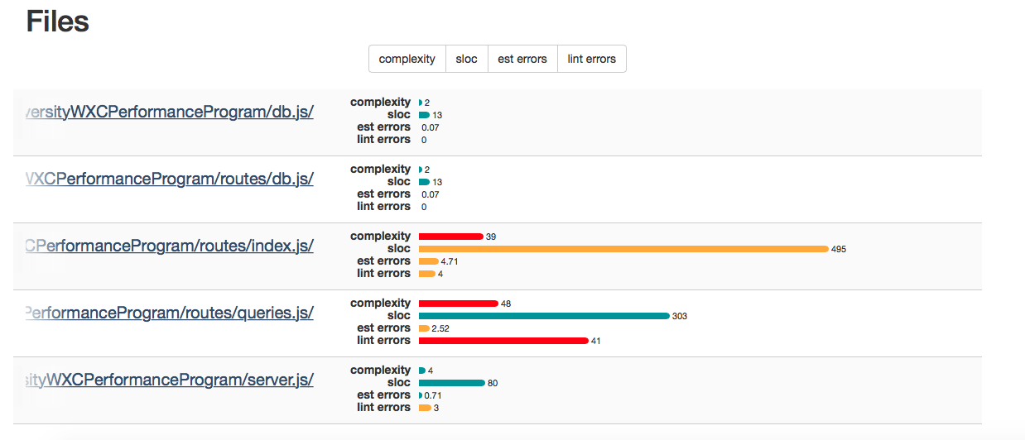
Output Post-Fix Cont’d

Slide 8
Overall Results
It appears most of the static analysis error found via Plato do not affect the functionality of the code, but make the code more readable and consistent with typing.
It is also nice to see where most of our code resides and the files we need to focus on to make sure our project is able to be maintained into the future.
My commits on git will show the addition of semicolons to fix many of the errors that were triggered by this analysis.

